Slide 1
Chapter 5
Analyzing the System

Slide 2
Review
A System is a collection of interrelated components that work together to achieve some common objective and System Analysis is the specification of what the system is required to do.
A Feasibility Study is conducted to find out whether the proposed system are:
  Possible – to build it with the given technology and resources
  Affordable – given the time and cost constraints of the organization
  Acceptable – for use by the eventual users of the system
The different aspects related to Feasibility Study are: Need Analysis, Economic Feasibility, Technical Feasibility, Legal Feasibility, and Evaluation of Alternatives.

Slide 3
Review Contd…
Project Proposal is the document that is prepared from the feasibility report, which outlines the characteristics of a system and gives first-cut calendar schedule.
Once the problem is analyzed and the essentials understood, the requirements must be specified in the Requirement Specification Document.
Requirements Gathering involves conducting a preliminary meeting with the client to understand and analyze his needs.
A software model must be capable of modeling the information that software transforms, its functions and behaviors.
OOA helps to create a precise and concise model of the problem in terms of real world objects.
Structured Analysis is a set of techniques and graphical tools that allow us to develop system specifications that are easily understandable by the user.

Slide 4
Review Contd…
A dataflow diagram is a pictorial representation of a system’s functions. Functions form part of various processes that are executed for a system.
Two components of the Essential Model are:
  Environmental Model
  Behavioral Model
Project sizing refers to estimating the size and complexity of a project.
Effort estimation refers to estimation of the amount of human effort required to do the project.
The project size can be measured by using the Program Complexity Method.
The most commonly used measure of source code program length is the number of lines of code.
Function Points measure size in terms of the amount of functionality in a system.
COCOMO can be used to estimate the development effort involved in a project.

Slide 5
Objectives
Describe system elements
Discuss Data Modelling
Explain the concepts of cardinality and modality
Examine Entity relationship diagrams
Discuss function modelling using DFDs
Describe Control Flow Model
Describe the data dictionary

Slide 6
System Engineering
System engineering is analyzing, designing and organizing a variety of elements into a product, service or technology.
When the system engineering deals with:
  a business enterprise, it is called information engineering
  a product to be built, it is called product engineering

Slide 7
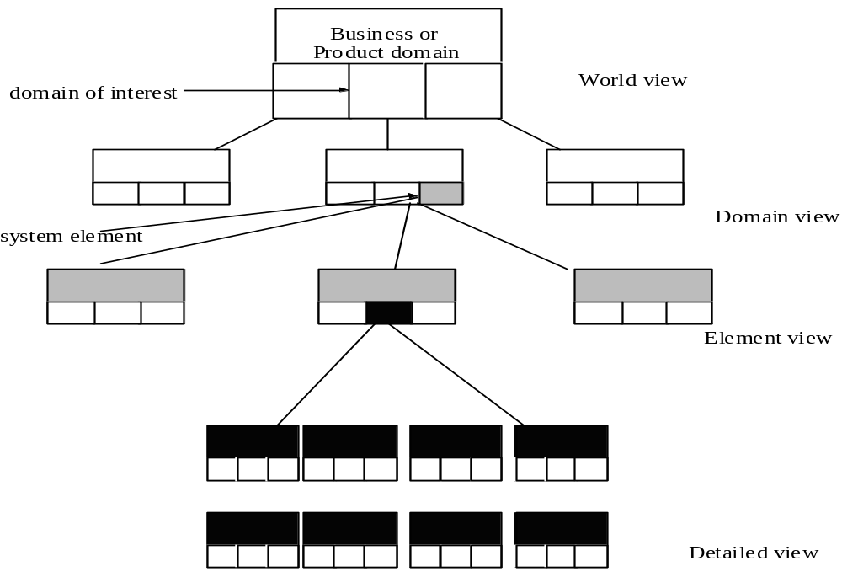
System Engineering Contd…
Source: “Software Engineering” - Roger Pressman

Slide 8
System Engineering Contd…
Two approaches to system engineering:
  Top-down approach
  Bottom-up approach

Slide 9
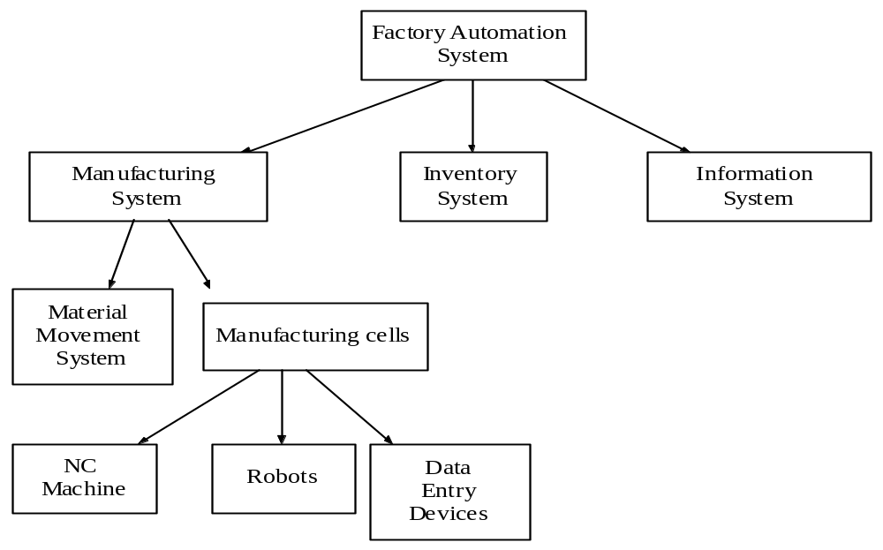
System Engineering Contd…
Source: “Software Engineering” - Roger Pressman

Slide 10
Data Modeling
Data modeling identifies:
  Primary data objects of the system
  Composition of each data object
  Attributes that describe the object

Slide 11
Cardinality
Definition:
Cardinality is the specification of the number of occurrences of one object that can be related to the number of occurrences of another object. Cardinality is usually expressed in terms of ‘one’ or ‘many’ combinations. - George Tillmann

Slide 12
Types of cardinality
One-to-one
One-to-many
Many-to-many

Slide 13
Modality
Definition:
Modality of a relationship is zero if there is no explicit need for the relationship to occur or the relationship is optional. Modality is 1 if an occurrence of the relationship is mandatory.

Slide 14
Entity Relationship Diagram (ERD)
Definition: An ERD is a graphical representation of the relationship between objects
  Originally proposed by Peter Chan
ER diagrams use:
  Rectangles to represent data objects
  Labeled line connecting objects to represent a relationship
  Number of special symbols to indicate cardinality and modality

Slide 15
Data Flow Diagrams (DFD)
Definition: A data flow diagram represents the movement of data within the system.
A DFD uses:
  Bubbles to represent functions
  Arrows to represent the data flows
    Arrows pointing towards the bubbles to represent input values
    Arrows pointing away from the bubble to represent output values
  Open boxes to represent data stores
  I/O boxes to represent data input and output during human-computer interaction

Slide 16
Control Flow
Control Flow Diagram (CFD) contains the same processes as the DFD but shows more control flow instead of data flow.
The control processes are represented using a notational reference to a control specification (CSPEC).
CSPEC represents the behavior of the system using:
  State Transition Diagram (STD), which provides a sequential specification of behavior
  Process Activation Table (PAT), which is a combinatorial specification of behavior

Slide 17
Data Dictionary
Definition:
Data dictionary is an organized listing of all data elements that are relevant to the system with precise and rigorous definitions so that the user and the system analyst will have a common understanding of inputs, outputs, components of stores and intermediate calculations.

Slide 18
Contents of a Data Dictionary
Data dictionary commonly contains:
  Name
  Alias
  Where used/how used
  Content description
  Supplementary information
Data dictionary may also contain:
  Data element definitions
  Table definitions
  ER models

Slide 19
Summary
A data model is a formal representation, which hides uninteresting details, highlights important facts, and gives a better understanding of the system to be built.
A representation of information that has a number of different properties or attributes and that can be understood by software, is called a data object.
Attributes define the properties of a data object and may serve one of the following purposes:
  To name an instance of the data object
  To describe the instance
  To make references to another instance in another table
Relationships are verbs used to indicate actions between any two data objects in the system.
Cardinality defines the maximum number of object-relationships that can participate in an association or relationship.

Slide 20
Summary Contd…
The modality of a relationship is zero if there is no explicit need for the relationship to occur or the relationship is optional. The modality is one if an occurrence of the relationship is mandatory.
An Entity-Relationship diagram identifies a number of components such as data objects, attributes, relationships and various type-indicators. The main objective of the ERD is to represent data objects and their relationships.
Data flow diagrams are typically used to represent a system or software at any level of abstraction.
Data flow diagrams provide mechanisms for function modeling as well as information flow modeling.
A Control Flow Diagram contains the same processes as the DFD but shows more control flow instead of data flow.
A data dictionary is a centralized collection of definitions of all the data flowing to or from data stores and/or processes.

